Slide 1
COMPUTER ARITHMETIC
INTRODUCTION
Computer Arithmetic introduces the fundamental issues related to the arithmetic operations and circuits used to support computation in computers such as number representations and base conversion.
This chapter introduces a number of algorithms together with hardware schemes that are used in performing integer addition, subtraction, multiplication, and division.
Ramadhani

Slide 2
COMPUTER ARITHMETIC
NUMBER SYSTEMS
A number system uses a specific radix (base). Radices that are power of 2 are widely used in digital systems. These radices include binary (base 2), octagonal (base 8), decimal (base 10) and hexagonal (base 16). The base 2 binary system is dominant in computer systems.
Ramadhani

Slide 3
Quantities/Counting
Decimal | Binary | Octal | Hexadecimal
0 | 0 | 0 | 0
1 | 1 | 1 | 1
2 | 10 | 2 | 2
3 | 11 | 3 | 3
4 | 100 | 4 | 4
5 | 101 | 5 | 5
6 | 110 | 6 | 6
7 | 111 | 7 | 7
8 | 1000 | 10 | 8
9 | 1001 | 11 | 9
10 | 1010 | 12 | A
11 | 1011 | 13 | B
12 | 1100 | 14 | C
13 | 1101 | 15 | D
14 | 1110 | 16 | E
15 | 1111 | 17 | F

Slide 4
Conversion among Bases
The possibilities:
Decimal
Octal
Binary
Hexadecimal

Slide 5
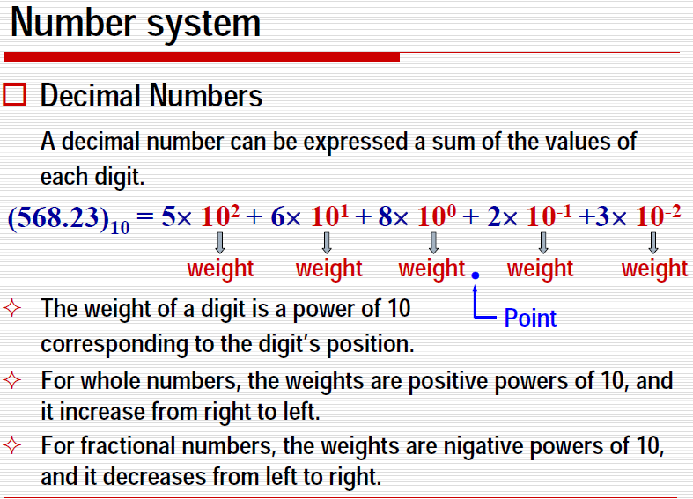
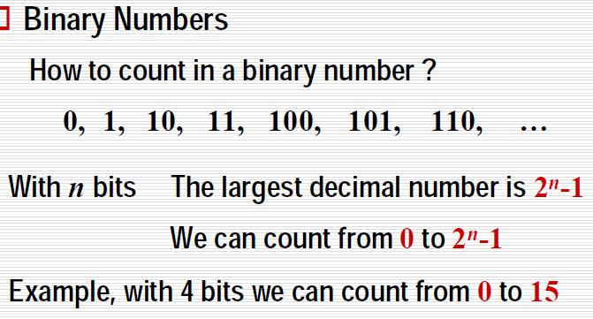
Quick Example

Slide 6
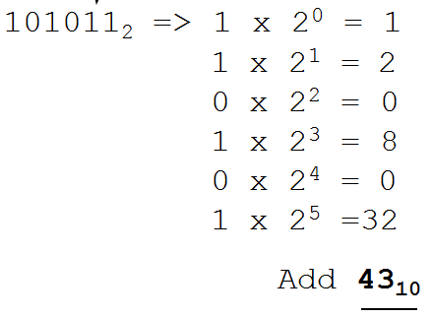
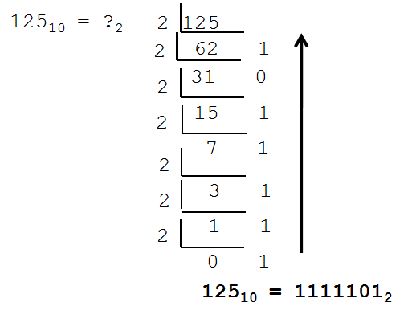
For example, the largest unsigned number that can be obtained using 4 digits in base 2 is equal to 2⁴-1=15.
In this case, decimal numbers ranging from 0 to 15 (corresponding to binary 0000 to 1111) can be represented.
Similarly, the largest unsigned number that can be obtained using 8 digits in base 2 is equal to 2⁸-1=255.
In this case, decimal numbers ranging from 0 to 255 (corresponding to 0000 to 3333) can be represented.
Another conversion Technique from Binary to Decimal
Multiply each bit by 2^{n}, where n is the “weight” of the bit and the weight is the position of the bit. Multiply each bit starting from right towards left. Then add the results

Slide 7
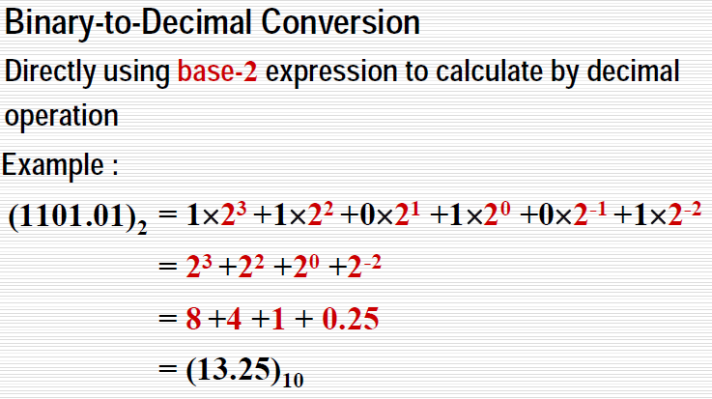
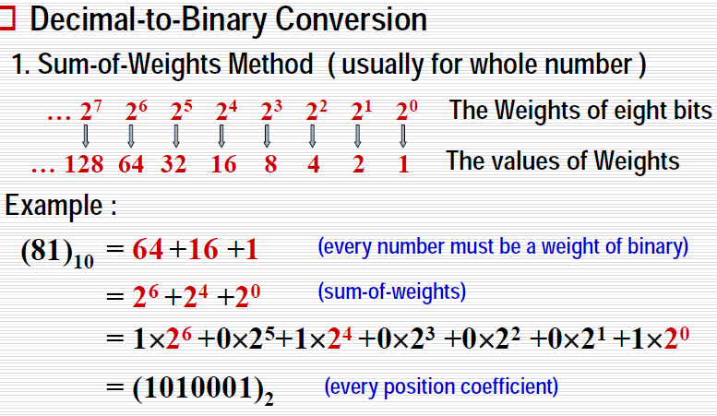

Slide 8
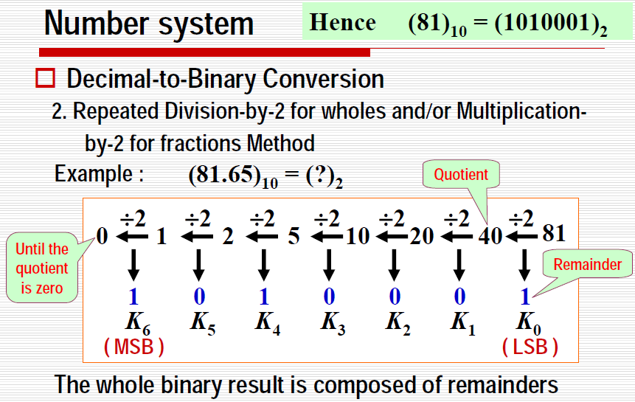

Slide 9
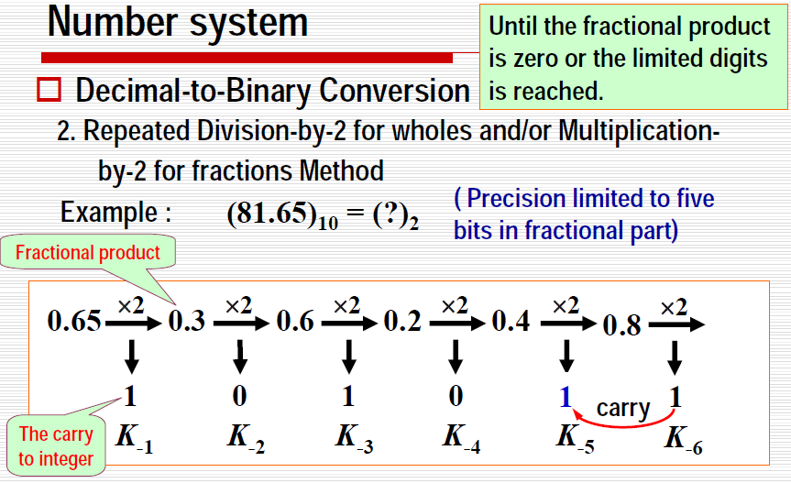

Therefore:
Where

Slide 10
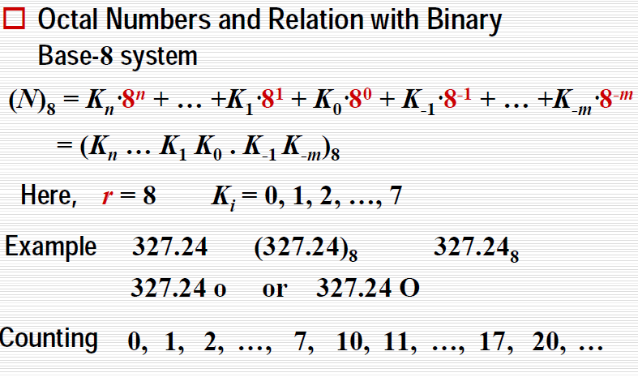
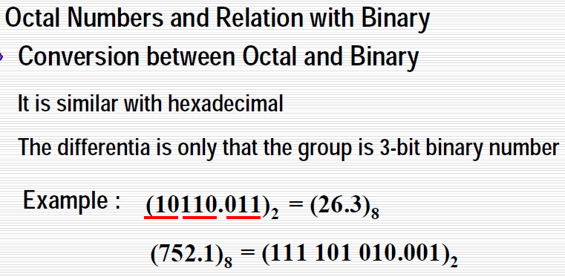

Slide 11
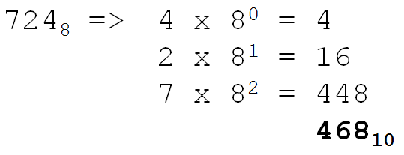
Conversion Technique from Octal to Decimal
  Multiply each bit by 8^{n}, where n is the “weight” of the bit. The weight is the position of the bit, Multiply each bit starting from right towards left. Then add the results
Decimal to Octal
Technique: Divide by 8, Keep track of the remainder
Decimal to Hexadecimal
Technique: Divide by 16, Keep track of the remainder

Slide 12
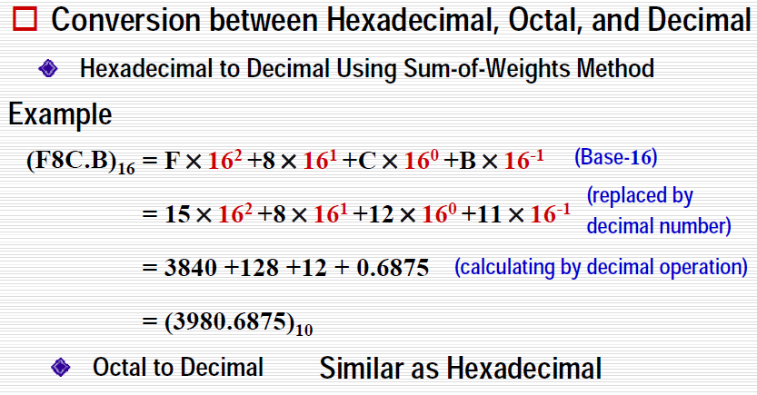
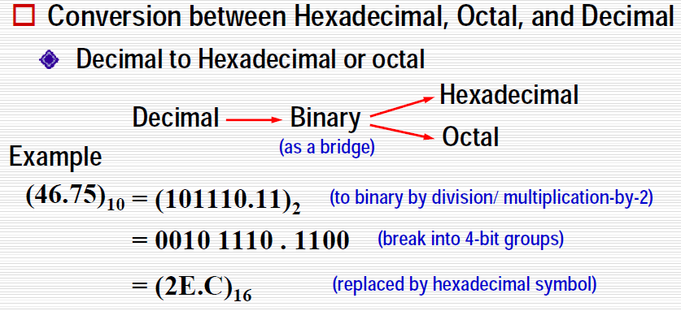

Slide 13
Exercise – Convert …
Decimal | Binary | Octal | Hexa- decimal
33
 | 1110101
 |  | 703
 |  |  | 1AF

Slide 14
Common Powers (1 of 2)
Base 10
Power | Preface | Symbol
10⁻¹² | pico | p
10⁻⁹ | nano | n
10⁻⁶ | micro | μ
10⁻³ | milli | m
10³ | kilo | k
10⁶ | mega | M
10⁹ | giga | G
10¹² | tera | T
Value
.000000000001
.000000001
.000001
.001
1000
1000000
1000000000
1000000000000

Slide 15
Common Powers (2 of 2)
Base 2
Power | Preface | Symbol
2¹⁰ | kilo | k
2²⁰ | mega | M
2³⁰ | Giga | G
Value
1024
1048576
1073741824
What is the value of “k”, “M”, and “G”?
In computing, particularly w.r.t. memory,
the base-2 interpretation generally applies

Slide 16
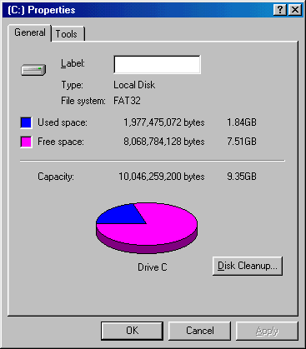
Example
In the lab…
1. Double click on My Computer
2. Right click on C:
3. Click on Properties
/ 2³⁰ =

Slide 17
Exercise – Free Space
Determine the “free space” on all drives on a machine in the lab
Drive | Free space
 | Bytes | GB
A:
C:
D:
E:
etc.

Slide 18
Review – multiplying powers
For common bases, add powers
a^{b} × a^{c} = a^{b+c}
2⁶ × 2¹⁰ = 2¹⁶ = 65,536
or…
2⁶ × 2¹⁰ = 64 × 2¹⁰ = 64k

Slide 19
Binary Addition (1 of 2)
Two 1-bit values
A | B | A + B
0 | 0 | 0
0 | 1 | 1
1 | 0 | 1
1 | 1 | 10
“two”

Slide 20
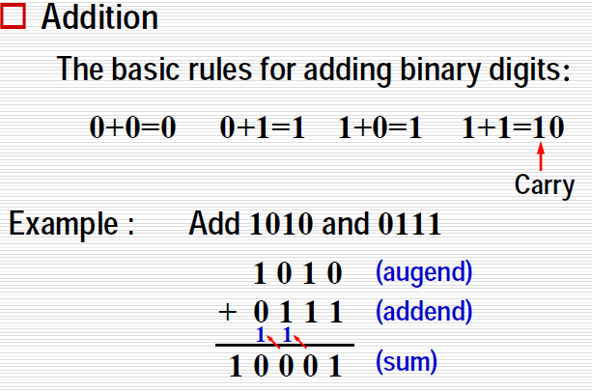
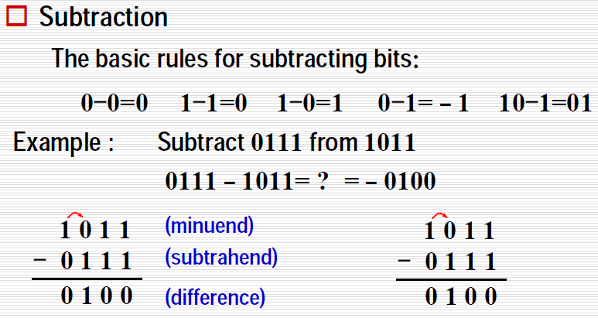
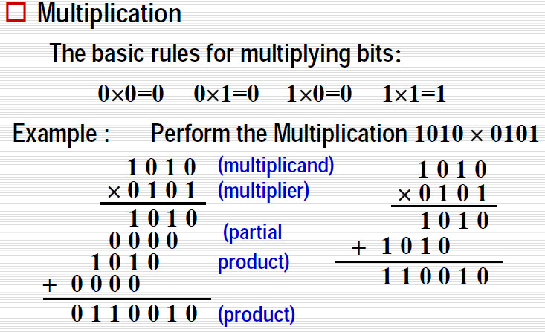
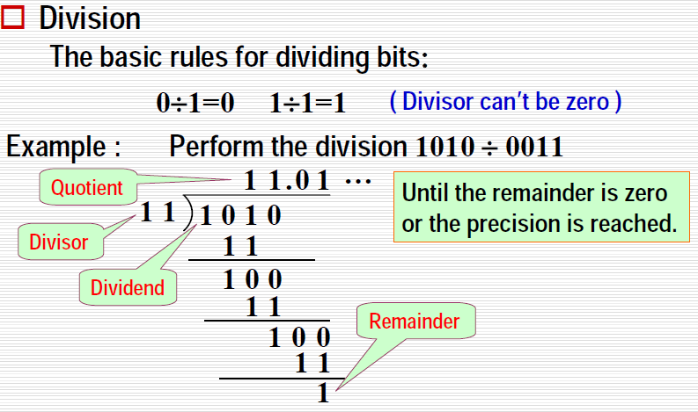
4.3 Binary Arithmetic

Slide 21
Binary Addition
Two n-bit values
  Add individual bits
  Propagate carries
  E.g.,
1
1
10101 21
+ 11001 + 25
101110 46

Slide 22
Multiplication
Binary, two n-bit values
  As with decimal values
  E.g.,
1110
x 1011
1110
1110
0000
1110
10011010

Slide 23
Fractions
Binary to decimal
10.1011 =>1 x 2⁻⁴ = 0.0625
1 x 2⁻³ = 0.125
0 x 2⁻² = 0.0
1 x 2⁻¹ = 0.5
0 x 2⁰ = 0.0
1 x 2¹ = 2.0
2.6875

Slide 24
Fractions
.14579
x 2
0.29158
x 2
0.58316
x 2
1.16632
x 2
0.33264
x 2
0.66528
x 2
1.33056
etc.
Decimal to binary
3.14579
11.001001...

Slide 25
Exercise – Convert ...
Decimal | Binary | Octal | Hexa- decimal
29.8
 | 101.1101
 |  | 3.07
 |  |  | C.82
Don’t use a calculator!
Skip answer
Answer

Slide 26
Exercise – Convert …
Answer
Decimal | Binary | Octal | Hexa- decimal
29.8 | 11101.110011… | 35.63… | 1D.CC…
5.8125 | 101.1101 | 5.64 | 5.D
3.109375 | 11.000111 | 3.07 | 3.1C
12.5078125 | 1100.10000010 | 14.404 | C.82

Slide 27
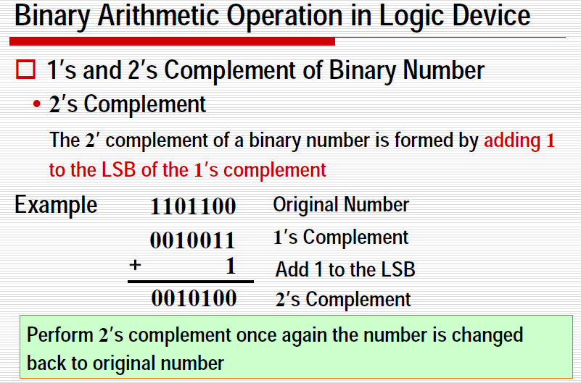
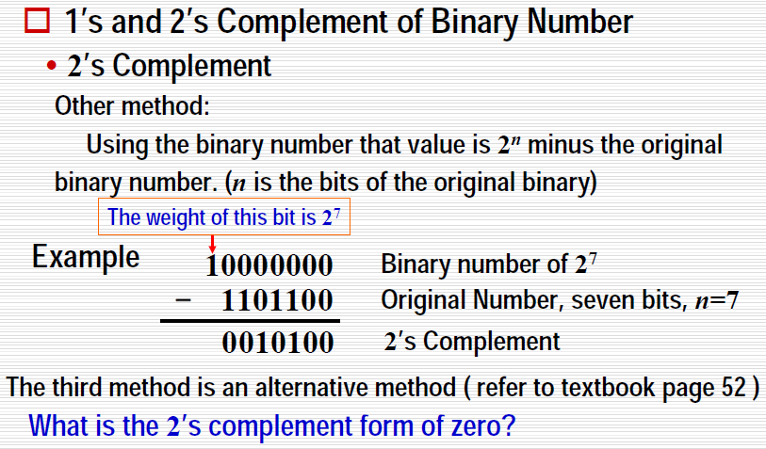

Slide 28
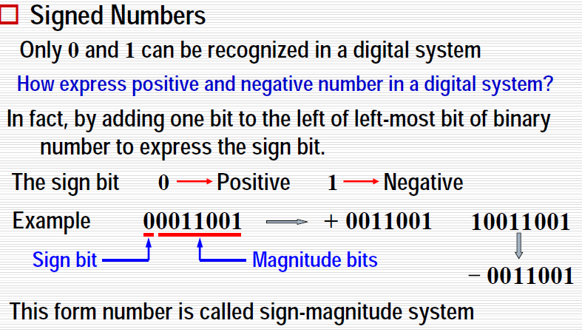
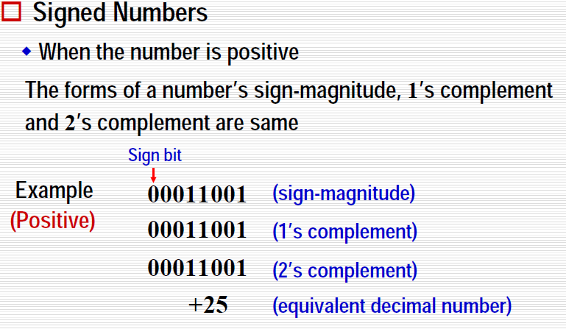

Slide 29
